Slide 1



Texas Community Development Block Grant Program
CDBG Over Coffee
Today’s Topic:
Fair Housing
Notes:
Good afternoon
Welcome and thanks for joining us for another CDBG Over Coffee, today’s topic is Fair Housing

Slide 2
Introduction
The Fair Housing Act of 1968 - Landmark legislation prohibiting discrimination concerning the sale, rental and financing of housing.
All recipients of TxCDBG funding must comply with provisions of the Act.
Notes:
The Fair Housing Act of 1968 is a landmark legislation that prohibits the discrimination concerning the sale, rental and financing of housing.
All recipients of TxCDBG funding must comply with provisions of the Act

Slide 3
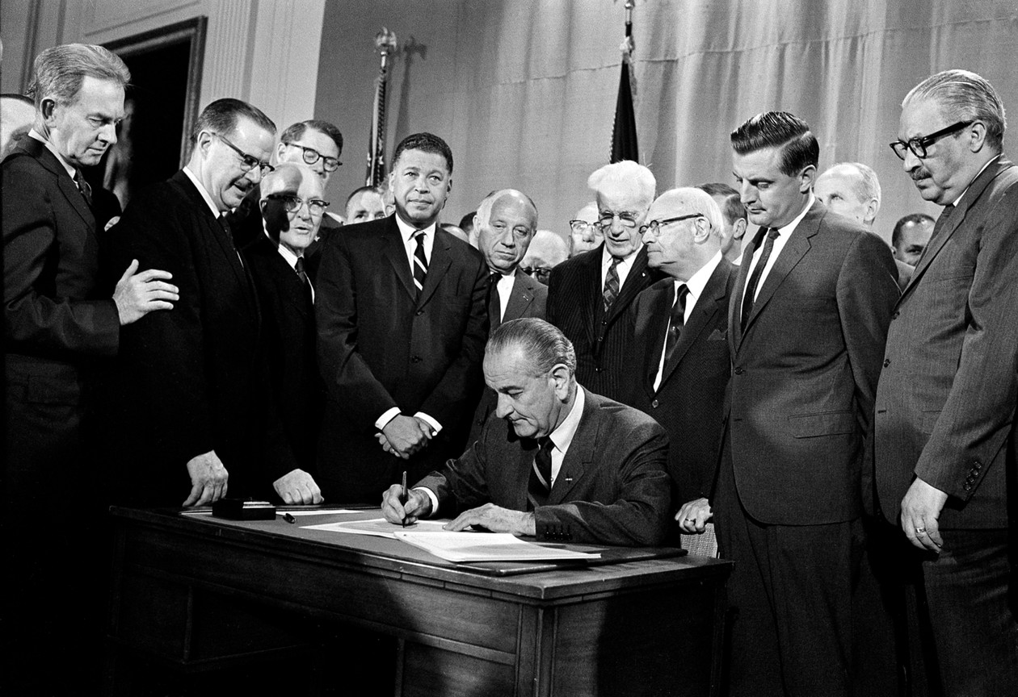
The Fair Housing Act
Was enacted in 1968
Prohibits discrimination in housing based on race, color, religion, sex, national origin, familial status, and disability.
Notes:
The Fair Housing Act, enacted by President Lyndon B. Johnson, prohibits discrimination in housing based on race, color, religion, sex, national origin, familial status, and disability. The act aims to ensure equal access to housing opportunities for all individuals.

Slide 4

Federal Enforcement
In 1968 it prohibited discrimination based on race, color, religion, sex and national origin
In 1988 disability and familial status were added.
Notes:
When the Fair Housing Act was first enacted, it prohibited discrimination only on the basis of race, color, religion, sex, and national origin. In 1988, discrimination against disability and familial status were added.

Slide 5

Section 808 (e) (5)
Is to affirmatively further the purposes of the Act by:
ensuring positive outreach, and
informational efforts to those who
are at least likely to know and apply
for housing
Entities receiving federal funds are required to apply and promote fair housing.
Notes:
Section 808(e)(5) of the Fair Housing Act is to affirmatively further the purposes of the Fair Housing Act, which includes ensuring positive outreach and informational efforts to those who are least likely to know about and how to apply for housing.
Under this section, entities receiving federal funds for a housing or community development purpose must administer the funds in a manner that affirmatively furthers fair housing and ensures the equitable and non-discriminatory distribution of critical community resources.
Similar to several other policies in the CDBG program, affirmatively furthering fair housing does not require particular groups to be prioritized in housing programs, but ensures that members of protected classes have the information and access to participate.

Slide 6

AFFH Certification
The Housing and Community Development Act of 1974 requires a recipient of CDBG funds to certify it will affirmatively further fair housing.
Exhibit D of the TxCDBG grant agreement contains the AFFH certification.
Notes:
The Housing and Community Development Act requires a non-entitlement grant recipient to affirmatively further fair housing in conformity with the Fair Housing Act.
The mandatory AFFH certification is contained in Exhibit D of the TxCDBG grant agreement.

Slide 7
Affirmatively Furthering Fair Housing
Grant Recipients must adopt (or affirm) a Fair Housing Policy by ordinance or resolution:
In the policy include a plan for fair housing activities
If the Grant Recipient is a city, pass a fair housing ordinance.
If the Grant Recipient is a county, adopt written fair housing policies and procedures that are equivalent to a fair housing ordinance.
Consult with their attorney or contact the applicable trade association for a sample fair housing ordinance or policy.
Notes:
To comply with this requirement, include in the policy a plan for activities that will affirmatively further fair housing in the community.
• If the Grant Recipient is a city, pass a fair housing ordinance. If possible, include a penalty clause in the ordinance.
• If the Grant Recipient is a county, adopt written fair housing policies and procedures that are equivalent to a fair housing ordinance.
• Grant Recipients should consult with their county/city attorney or contact the applicable trade association (Texas Municipal League or Texas Association of Counties) for a sample fair housing ordinance or policy.

Slide 8

Taking Action
Publicize the fair housing policy through newspaper publication, fliers enclosed in utility bills, or public service announcement.
Host a fair housing booth for a local event.
Designate April or any other month as Fair Housing Month.
Have a written local complaint and monitoring process for the fair housing policy.
Notes:
The following are fair housing activities the Grant Recepient can complete to fulfill this requirement;
Publicize the fair housing policy through newspaper publication, fliers enclosed in utility bills, or public service announcement,
• Host a fair housing booth for a local event.
• Designate April or any other month as Fair Housing Month by Proclamation or Resolution along with another sponsoring activity. Another fair housing activity must take place if this activity is chosen.
• Have a written local complaint and monitoring process for the fair housing policy and notify the public of its existence through newspaper advertisements, or through notices in utility statements.

Slide 9

Ideas for Fair Housing Activities
Conduct a community-wide housing analysis to determine impediments to fair housing and implement actions to eliminate these impediments.
Sponsor or fund fair housing counseling/referral services for owners and renters.
Promote housing opportunities outside historically minority and/or low- and moderate-income neighborhoods.
Utilize local businesses and banking institutions (minimum of 15 organizations) to promote fair housing by displaying fair housing posters.
https://nationalfairhousing.org/wp-content/uploads/2021/12/NFHA-Fair-Housing-PSA-Catalog-June-2021.pdf
Notes:
• Conduct a community-wide housing analysis to determine impediments to fair housing and implement actions to eliminate these impediments.
• Sponsor or fund fair housing counseling/referral services for owners and renters.
• Promote housing opportunities outside historically minority and/or low- and moderate-income neighborhoods.
• Utilize local businesses and banking institutions (minimum of 15 organizations) to promote fair housing by displaying fair housing posters.

Slide 10
Ideas for Fair Housing Activities
Conduct free training workshops on fair housing laws to homebuyers, rental property owners, and tenant organizations.
Sponsor a poster contest or essay writing contest at local schools to educate and promote fair housing.
Review local zoning laws and procedures to determine whether they contribute to, or detract from, fair housing choice. Conduct a public meeting to discuss the analysis and conclusions.
Find ways to inform builders and architects as early as possible in the project design phase, but certainly no later than the issuance of a building permit, of the need to comply with the accessibility requirements of the Fair Housing Act.
Notes:
• Conduct free training workshops on fair housing laws to homebuyers, rental property owners, and tenant organizations.
• Sponsor a poster contest or essay writing contest at local schools to educate and promote fair housing.
• Review local zoning laws and procedures to determine whether they contribute to, or detract from, fair housing choice. Conduct a public meeting to discuss the analysis and conclusions.
• Find ways to inform builders and architects as early as possible in the project design phase, but certainly no later than the issuance of a building permit, of the need to comply with the accessibility requirements of the Fair Housing Act.

Slide 11

Fair Housing Activities Resources
HUD fair housing overview
HUD fair housing planning guide
TDHCA sample fair housing resources
NFHA fair housing posters
Notes:
Resources found on online include:
HUD’s overview of fair housing and complaint procedures
HUD’s fair housing planning guide
The Texas Department of Housing and Community Affairs has collected a number of resources and sample documents
The National Fair Housing Alliance publishes a variety of posters promoting fair housing
Note: HUD has recently updated its website, including the fair housing information available. The links provided are active at the time of this webinar; you may also search for these key words if the information is moved in the future.

Slide 12
Filing a Complaint
The Texas Workforce Commission (TWC) is the entity responsible for enforcing the Fair Housing Act in the State of Texas.
Texas Workforce Commission
Civil Rights Division
1117 Trinity Street, Room 144-T
Austin, Texas 78701
(888) 452-4778 or (512) 463-2642
TTY: 512-371-7473
Fax: 512-463-2643
https://twc.zendesk.com/hc/en-us/articles/10249166006683-How-do-I-file-a-Fair-Housing-Complaint
Notes:
The Texas Workforce Commission (TWC) is the entity responsible for enforcing the Fair Housing Act in the State of Texas. Complaints can also be made directly to HUD. Citizens have one year after an alleged violation to file a complaint. Complaints can be filed by email, fax, phone call, hand-delivery, or mail to the Texas Workforce Commission.

Slide 13
Thank You For Your Attention
Time for Questions
Notes:
And this concludes our presentation, thank you for attending and now the microphones will open for questions.

